Slide 1
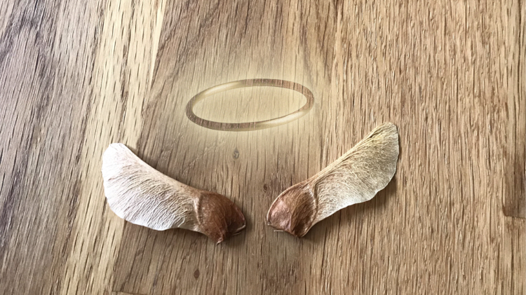
Myth Project
An Original Song By Pippa Stanton

Slide 2
Intro
I will fly, past the sun
But when I fall, oh so young
Ill be falling, falling//
To obliv-i-on
Obliv-i-on
Yea
Verse
Icarus was a lonely lad
Wasted away in the tower with is dad
Stuck their with just a view of the sea
Longing to be a bird
Verse
Icarus was a lonely lad
Wasted away in the tower with is dad
Stuck their with just a view of the sea
Longing to be a bird
Longing to free
Verse
With anger to the king, for imprisoning his son
He took matter in his hands, Engineering begun
taking feathers he began, weaving in and out
to and though his hands went
no need to stop!
all for his son, wonderful son
his son
Chorus
Birds fly, across the sky
But you fall, the dearest of them all
Threadbare blankets can only do so much
When one needs comforts needed, who can you trust?
Verse
Daedalus did not want for this to be
Daedalus wanted for his son to be free
Daedalus longed for the freedom of his home
Daedalus asks the gods what he did wrong

Slide 3
Chorus
Birds fly, across the sky
But you fall, the dearest of them all
Threadbare blankets can only do so much
When comforts needed, who can you trust?
Verse
Callused fingers, rough to the touch
Burning wax, turning tough
Sweet words promising freedom heed
Don’t fly to high
Don’t go two low
Follow my lead
well get out this time, I promise, I know
Verse
The sun shines down upon the sea
Taunting to Icarus `be you cant go as high as me’
Foolish young Icarus of course follows, to young to what will follow
Verse
His fathers words echo in his head
If he only listened, what would be instead
Tapered wings plumet the sky, as wax melts from going to high
His arms go up, legs flail
His death bed now the Aegean sea

